Slide 1
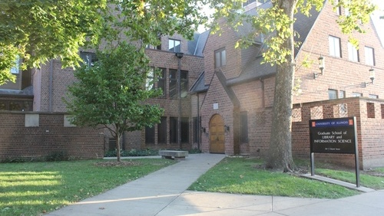

Programming Analytics
Group Members:
Jainam Avlani
Adarsh Kumar
Mithil Shah Friday, 2nd Dec 2021.

Slide 2


Introduction
World War 2 led countries to Fascism.
Understanding the concept of Psychology of Money.
Project Aim is to analyze growth of GDP after World War 2.

Slide 3
Hypothesis 1
Low interest rates post World War 2 helped in eventually increasing the GDP for United States of America.
H0 : Low interest rates helped increase the GDP of United States of America.
HA : No effect of GDP on the economy of United states of America.
Data used: GDP and Year
Data Source: World Bank Data, Fred

Slide 4
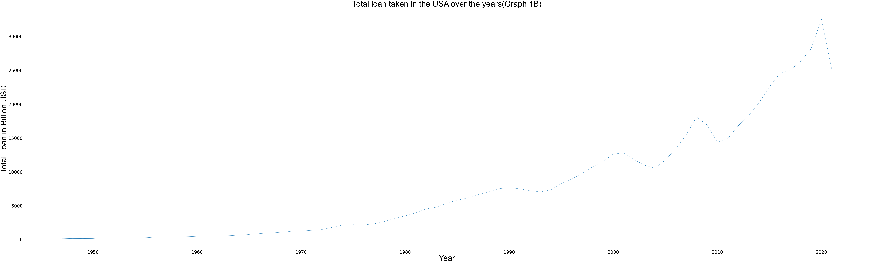
Hypothesis 1
As shown above in the Graph 1B, the total loan that was taken over the years post WWII has increased. However, there is a slight downward trend scene around 2009 due to the great recession and around 2020 due to COVID.

Slide 5
Hypothesis 2
Low interest rates and easy availability of loans post the World War 2 transformed the USA from savings household economy to spending economy.
H0 : Low interest rates and availability of loans helped increase the GDP of United States of America.
HA : No effect of GDP on the economy of United states of America.
Data used: Income. Personal expenditure
Data Source: United States Census Bureau,World Bank Data, Fred

Slide 6
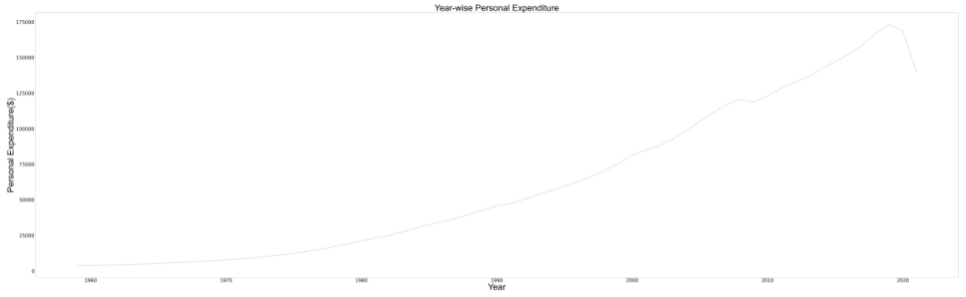
Hypothesis 2
This plot shows the trend of increase in personal expenditure of the people of USA.

Slide 7
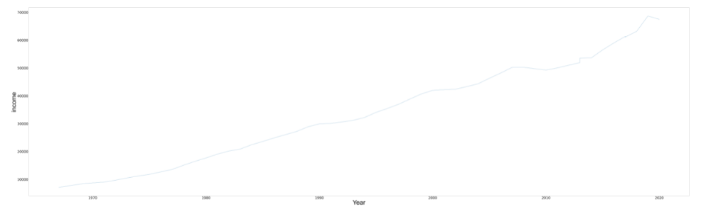
Hypothesis 2
This plot shows the trend of increase in income of the US population.

Slide 8
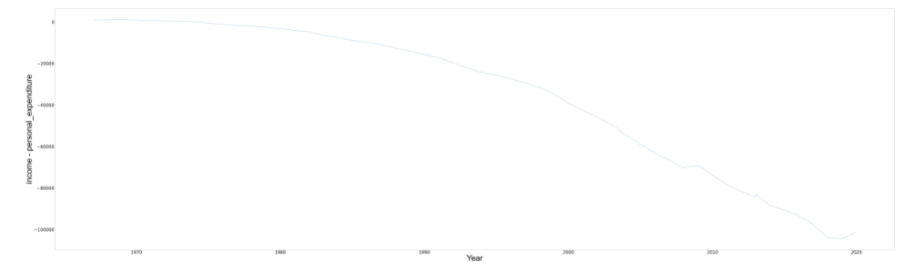
Hypothesis 2
Imposing less interest rates led the US economy to become a spending economy.
This have led people of spending more than their earnings.

Slide 9
Hypothesis 3
Does the habit of taking loans and credit to live a lavish American lifestyle, has led American population below the poverty level over the years
H0 : Loans and Credit has led more percent of Americans below poverty level over the years.
HA : No effect poverty on the American population.
Data used: tableD1.xlsx
Data Source:
United States Census Bureau https://www2.census.gov

Slide 10
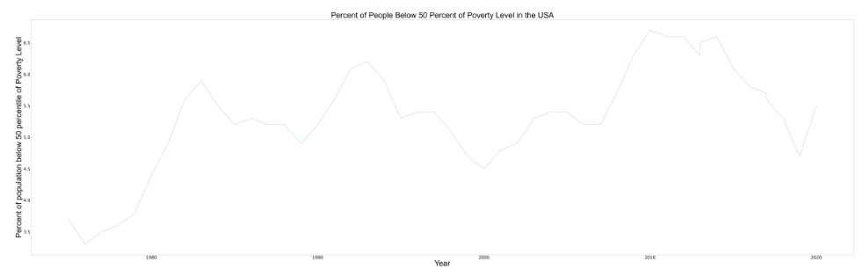
Hypothesis 3
There are many other factors that affect the poverty rate (i.e.) Recession, natural calamities etc.
Spending more money is not the only reason behind the increase in poverty rate.
Over the last few year, the poverty % is increasing at almost a constant rate.

Slide 11

Thank You!
Questions?

